Slide 1
Word Frequency with Tragedies
Noah Cash

Slide 2
What was the question?
Does William Shakespeare have similar writing style within his writing? Is it different to other authors in same era? (1600’s)
Can we distinguish an author's writing style from one other by using word frequency?

Slide 3
What was the approach?
The first approach was to use two works from Shakespeare, one from Webster to compare.
To get the data, I had to clean up the data by removing stop words and the beginning text of the Project Gutenberg website.
I then computed the word frequencies to get the top 15 most used words in each work.
I also identified words that were used by one play and not the other.

Slide 4
What were some problems
I would say that the hardest part of this was cleaning up the data to present it on the graphs.
The Project Gutenberg website has a beginning chuck of words that is not in the works, so I had to remove it from data collection.

Slide 5
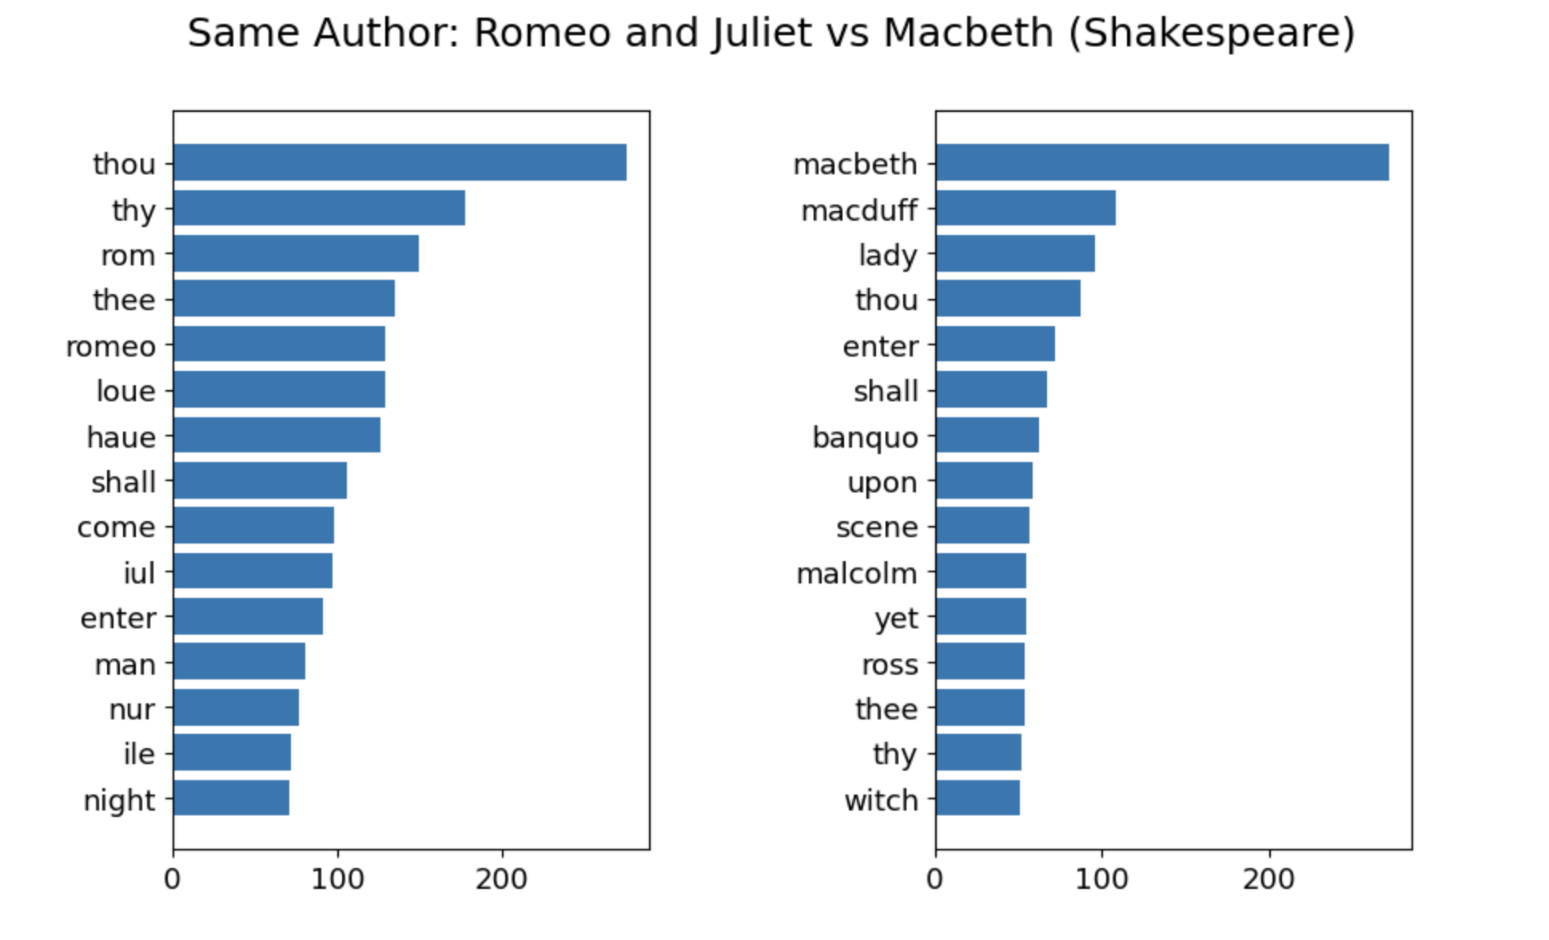
What were the results? (Same Author)

Slide 6
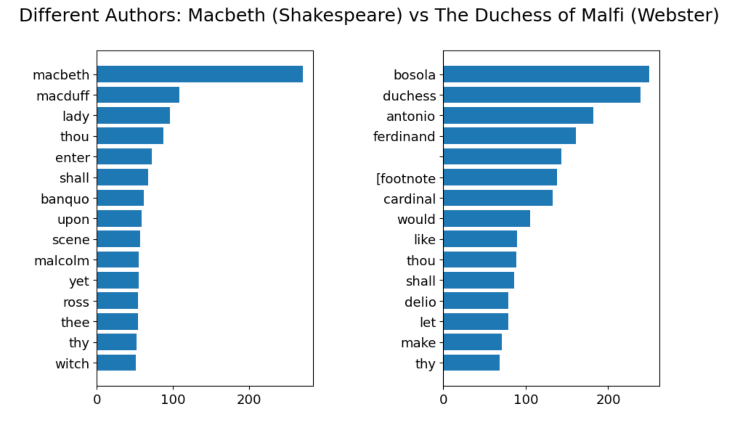
What were the results? (Different Author)

Slide 7
What are new ideas?
The use of archaic pronouns (thou, thy, thee) is not really a sign of a writing style but rather a reflection of the time period it was written in (Jacobean Era)
What would happen if I used the same technique to playwrights in today’s era? Just to see what types of words would be most popular.

